Slide 1
Hotel Server APP
BY
1. NACHIAPPAN RM
2. KARTHIK K

Slide 2
About the System
-> To create a system to manage orders in a restaurant
-> Each order is tracked with the help of table number from which order is placed, and has ordered foods with quantities.
-> There will be 2 ends one is from waiter and other is for chef.
-> Waiter can place the order.
-> Chef can view the detailed order which is ordered from waiter end.
Presentation Video Link : https://fluvid.com/videos/detail/Z_35Ai16nyI7Owwpo
Github Link : https://github.com/karthik-kantam/Hotel-Server-App

Slide 3
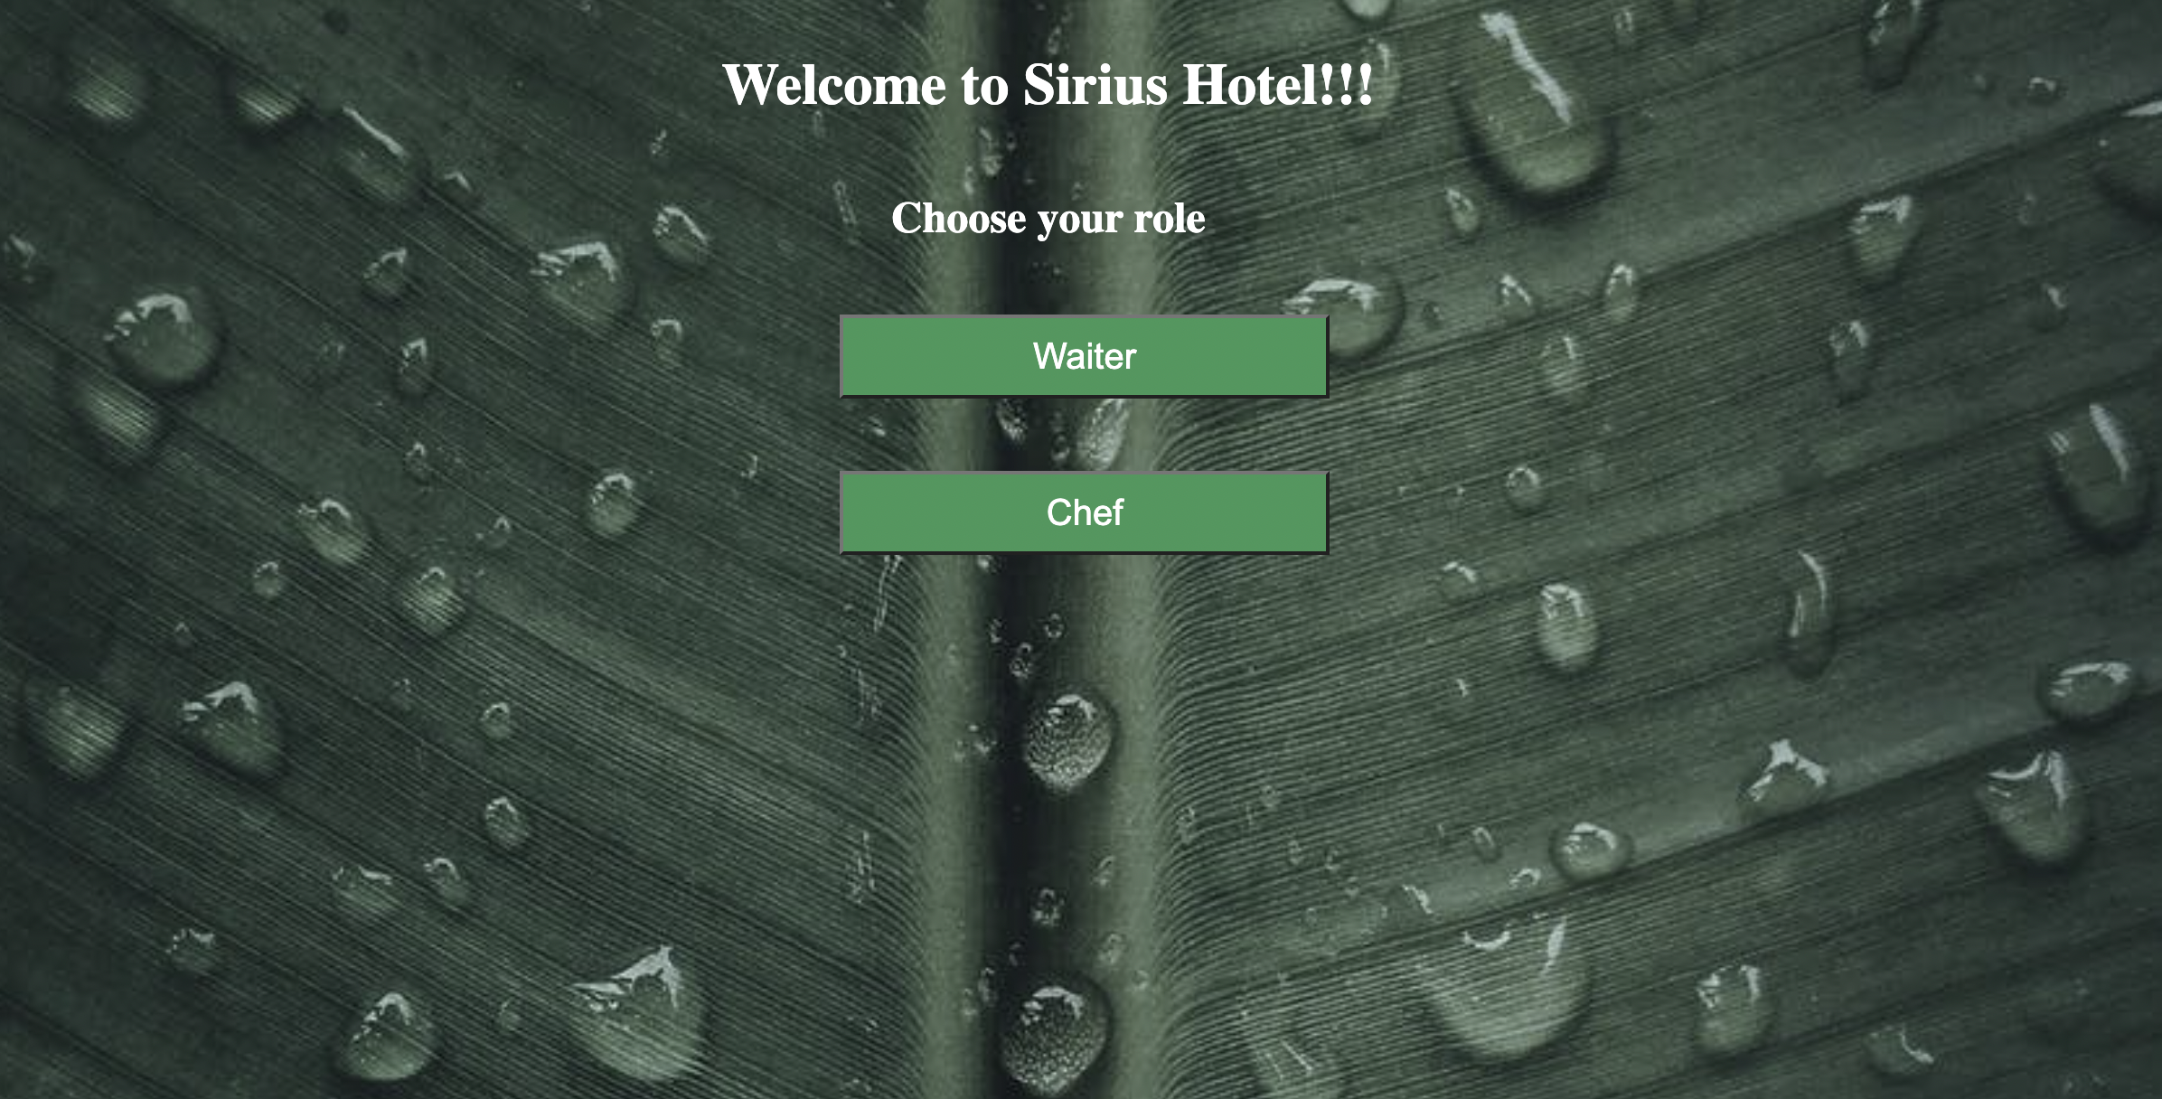
Welcome Page
Unified landing page for both actors
- Waiter can directly order.
- Chef has to login in order to view
Orders placed by waiters.

Slide 4
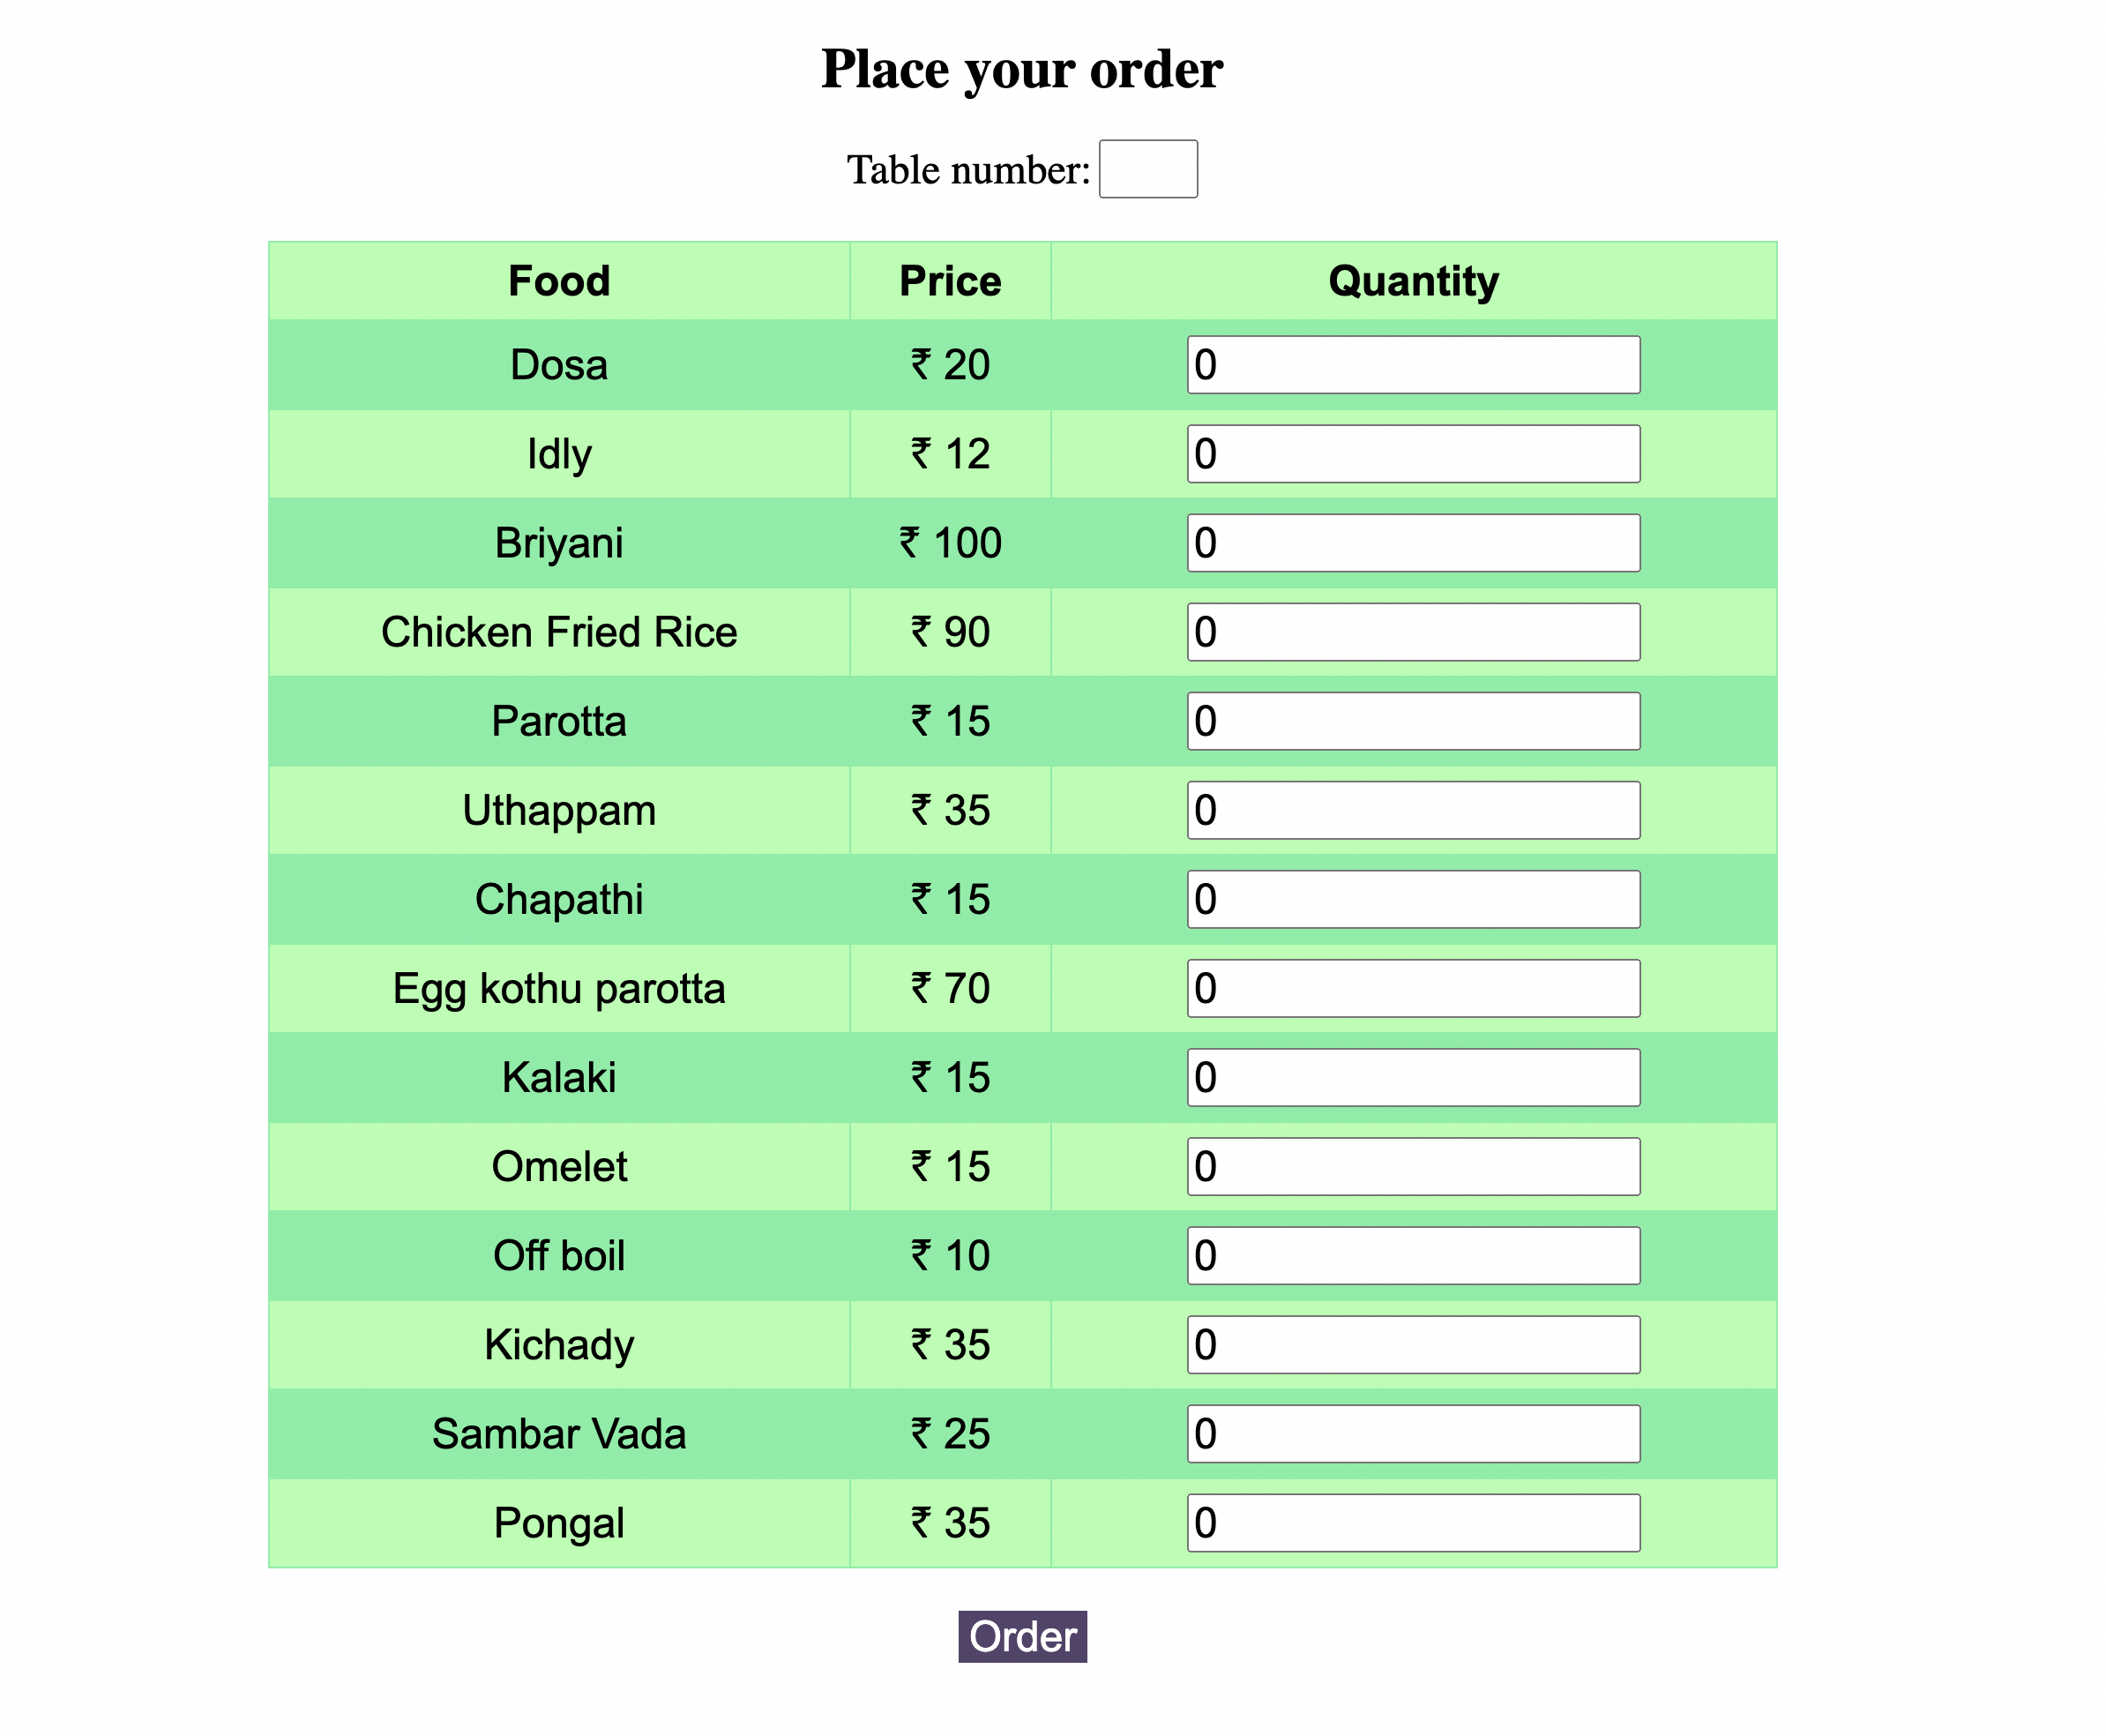
Our Menu
Page from where Waiter place the Order
Table number and Quantities are entered
by waiter and by clicking order, order will
be placed.

Slide 5
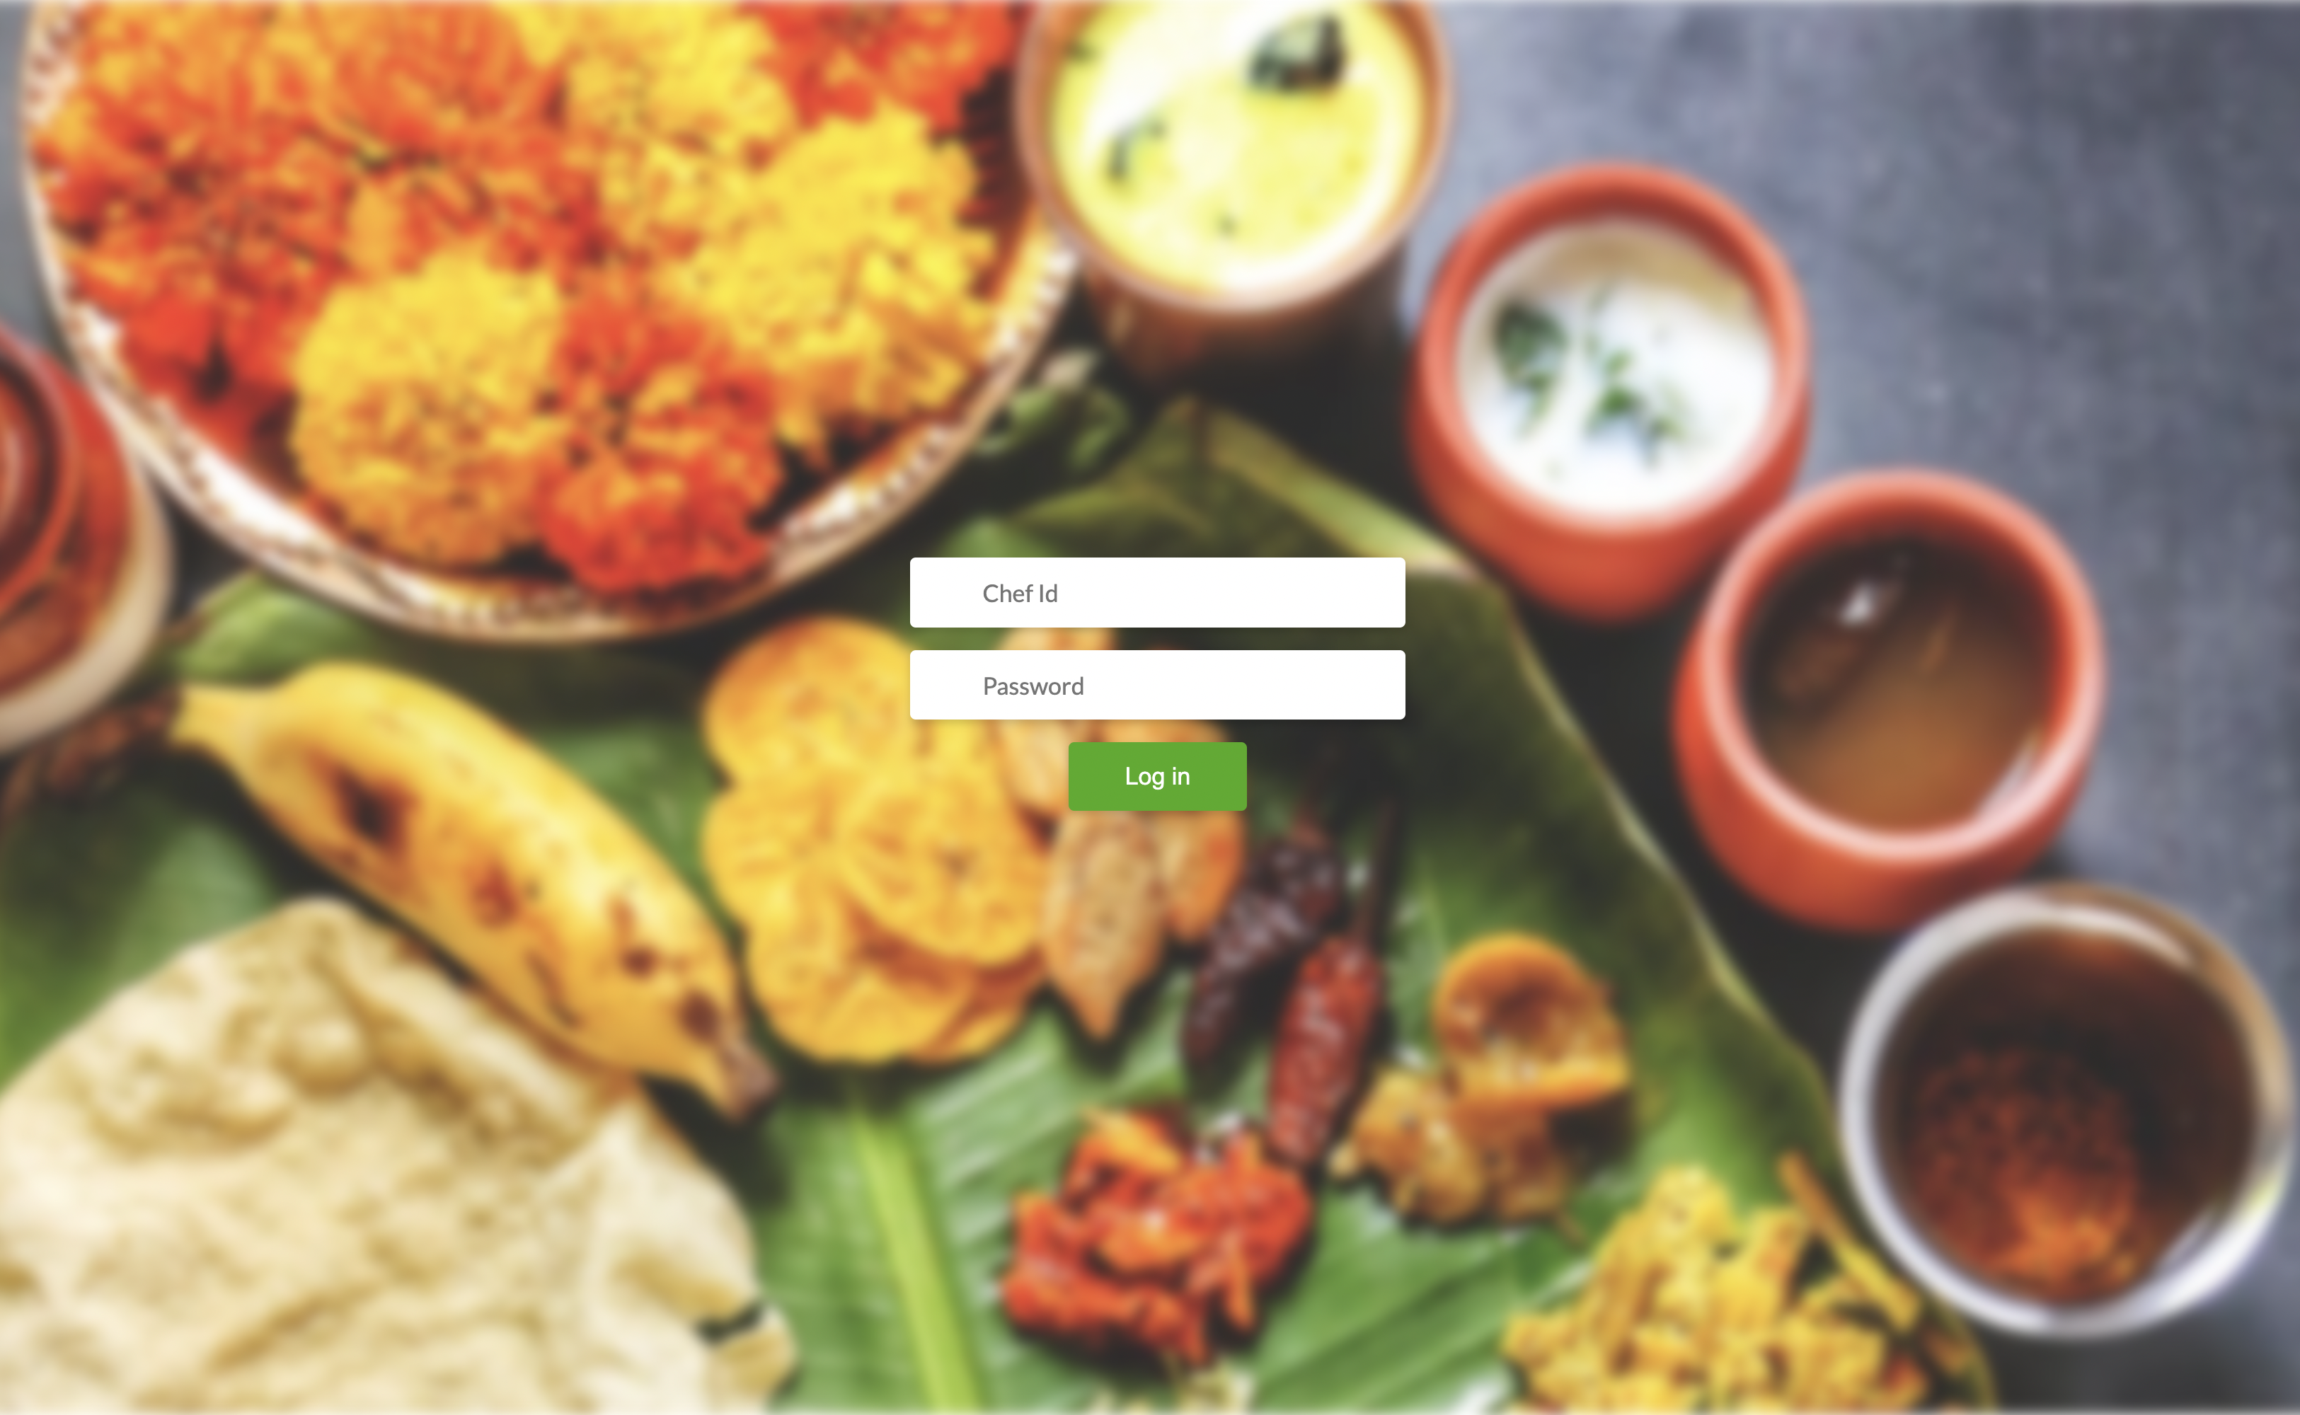
Chef Login
Chef login page,
Here chef need to login using his
Id and password.

Slide 6
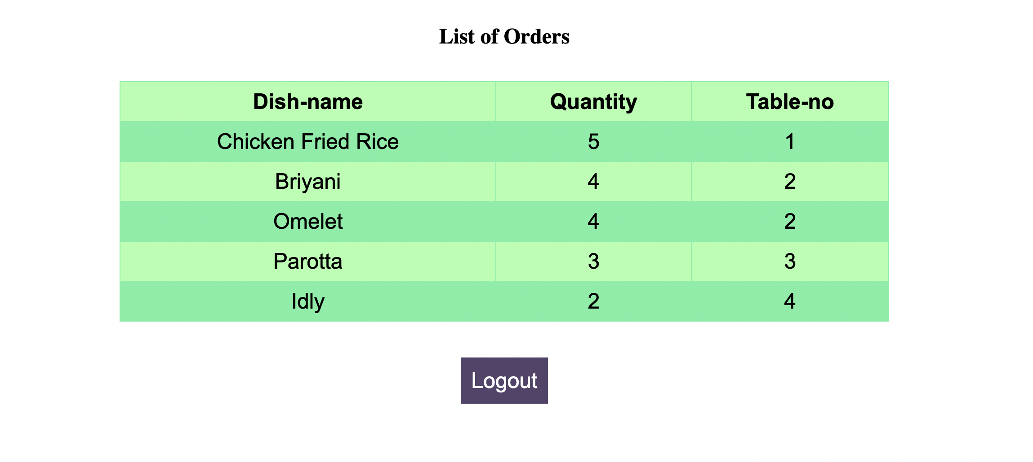
Orders
The ordered food items along with table number will be visible to chef once he logged in.

Slide 7
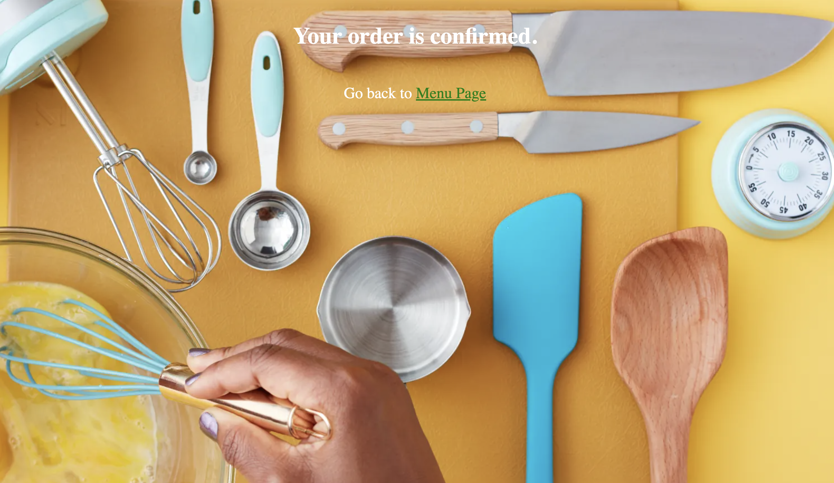
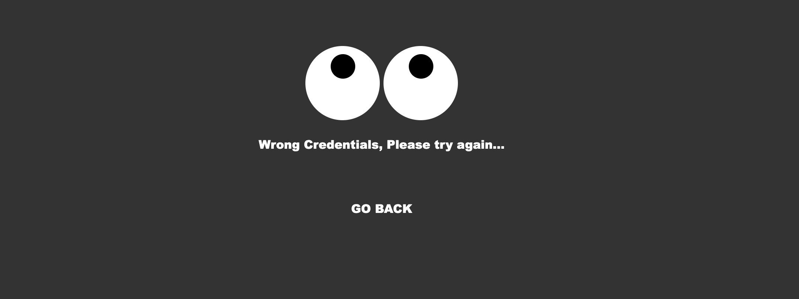
Snapshots
Order confirmation page and wrong credential page.

Slide 8
Thank You!!!

